Slide 1
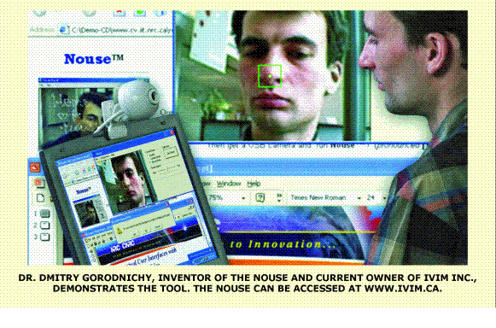
NOUSE TECHNOLOGY:

Slide 2
INTRODUCTION:
The "Nouse," short for "nose as mouse," is the brainchild of Dmitry Gorodnichy, research officer at the National Research Council's Institute for Information Technology.
It uses movements of the tip of the user's nose to direct the cursor, which is normally controlled by a conventional mouse
This technology will enable computer users to use their eyes and nose

Slide 3
Technology Specifications:
NOUSE SOFTWARE VERSION 2.11
SYSTEM REQUIREMENT
Pentium IV2 GHZ or more
Microsoft windows 2000,xp or vista
1 GB of RAM or more
Install USB web Camera

Slide 4
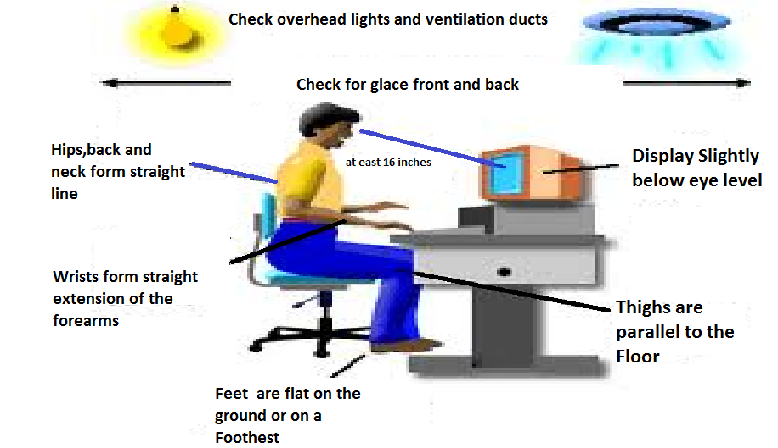
HOW CAN WE USE THIS TECHNOLOGY??

Slide 5
Desired feature properties:
Convex-shape features:
Convex-shape features are those points on the surface of the object which are seen by the camera as the points of same curvature during the motion of the object.
Nose feature:
Nose feature is defined as the point on the nose surface that is the closest to the camera.

Slide 6
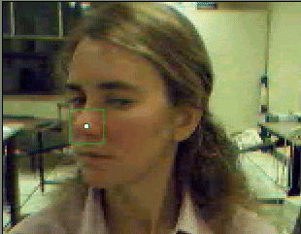
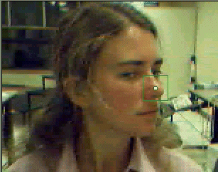
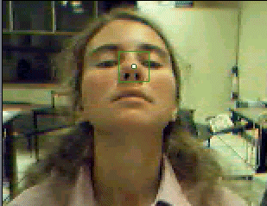
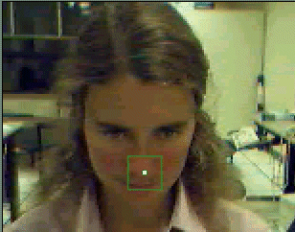
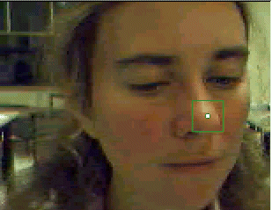
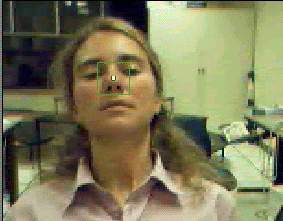

Slide 7
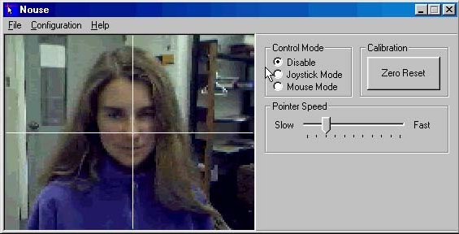
The Nouse technology:
It consists three stages:
1) Initialization
2) Tracking and
3) Mouse and joystick modes

Slide 8
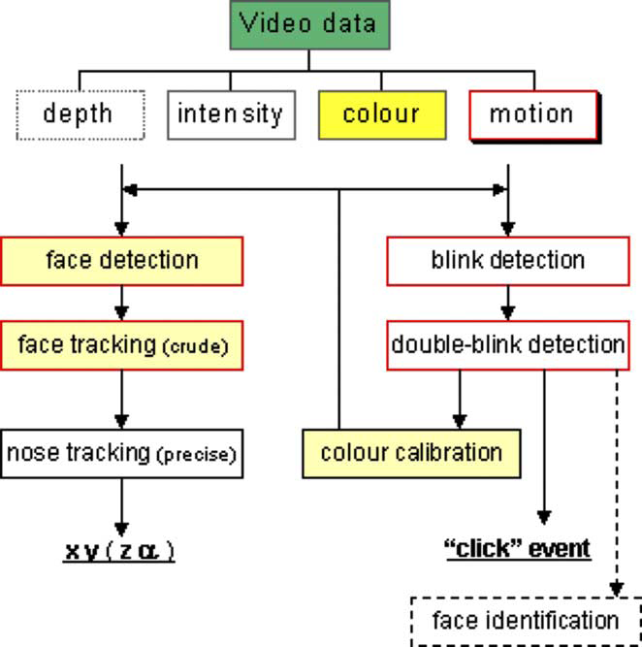
Nouse perceptual vision systems:

Slide 9
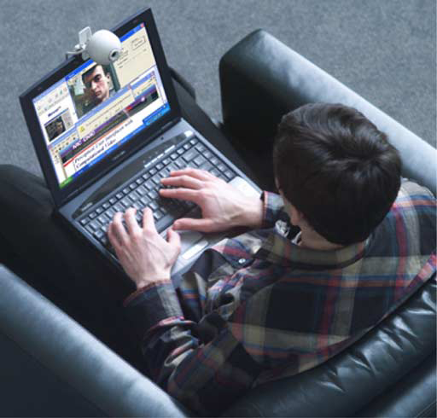
Detection of eye Blink:
Vision-based perceptual user interface at work:
a laptop with a webcam mounted on its top allows a user to use Nouse and Doubleblink to select hands-free a ‘Yes’ button in a pop-up ‘Continue?
k Yes l No l Cancel k window.

Slide 10
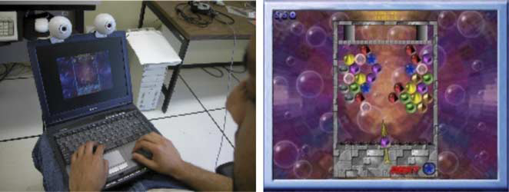
Setup for stereotracking:

Slide 11
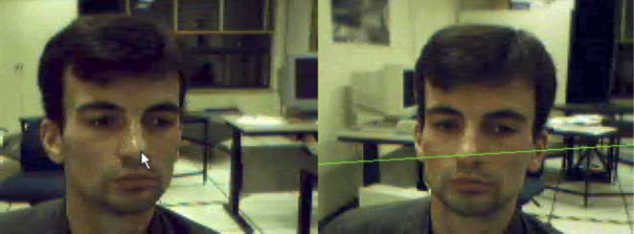
Examining the quality of stereo calibration. The features to be tracked must lie on the epipolar lines.

Slide 12
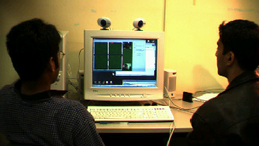
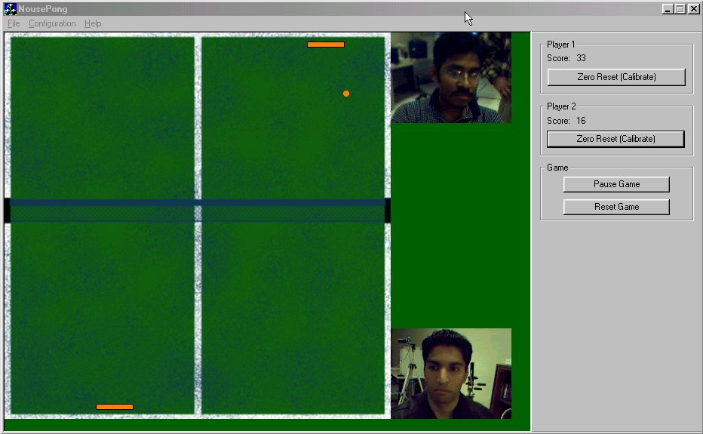
By using stereotracking, Multiple User work at a time

Slide 13
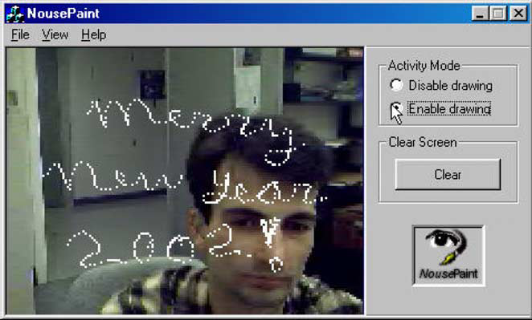
Demo of this technology:

Slide 14
Application:
Navigation in Windows,
NousePaint,
Aim-n-shoot BubbleFrenzy game,
NousePong.

Slide 15
Advantages:
This technology is very useful for handicap people who are disable to use computer
Security purpose

Slide 16
Conclusion:
Because of the low prices and the ease of installation, USB cameras have become very popular nowadays
We show that a human face possesses a very unique feature—the nose
Combined with other perceptual mechanisms, such as blink detection, our face-tracking technology allows one to build complete intelligent hands-free alternatives, or extensions, to conventional tangible input devises such mouse or joystick.

Slide 17
Any Question???

Slide 18
Presented by:
Patel Janki(D11CE01)

Slide 19
Thank you

